Slide 1

Note: The data and information in this document is reflective of a hypothetical situation and client. This document is to be used for KPMG Virtual Internship purposes only.
Sprocket Central Pty Ltd
Data analytics approach
[Division Name] - [Engagement Manager], [Senior Consultant], [Junior Consultant]

Slide 2
Note: The data and information in this document is reflective of a hypothetical situation and client. This document is to be used for KPMG Virtual Internship purposes only.
Agenda
Introduction
Data Exploration
Model Development
Interpretation

Slide 3
Note: The data and information in this document is reflective of a hypothetical situation and client. This document is to be used for KPMG Virtual Internship purposes only.
Introduction
Data Exploration
We can explore the data by considering a few factors for our new customers.
Age Distribution of the new customers has changes from the previous ones.
Wealth segments of the new customer also matter while buying new products.
Job industry is the another factor that we can count.
.

Slide 4
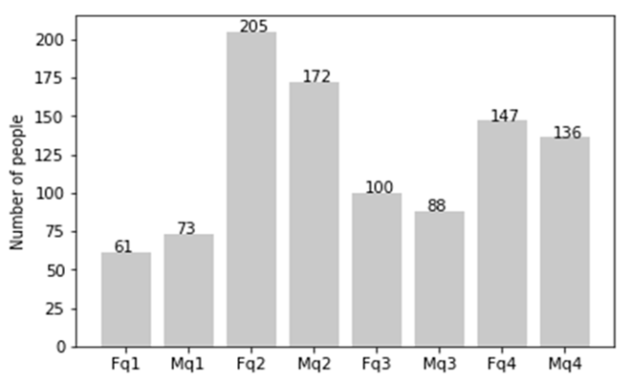
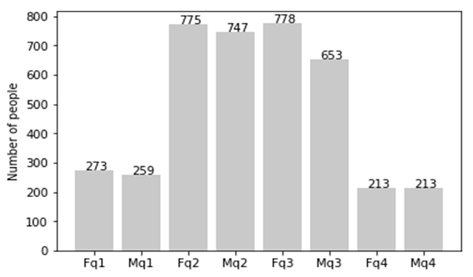
Note: The data and information in this document is reflective of a hypothetical situation and client. This document is to be used for KPMG Virtual Internship purposes only.
Data Exploration
Age Distribution
Mostly our new customers lies in the range of 25 to 48 as we can see the changes in Fq2 in both the graphs.
Customers belonging to age group 48 to 59 years has shown a downward fall.
Increase in the number of customers with age over 59 years.
q1: Under 25; q2: 25 to 48; q3: 48 to 59; q4: Over 59
Place any supporting images, graphs, data or extra text here.

Slide 5
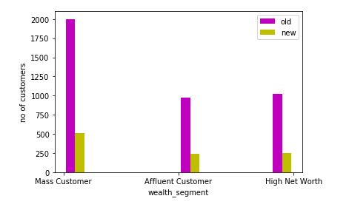
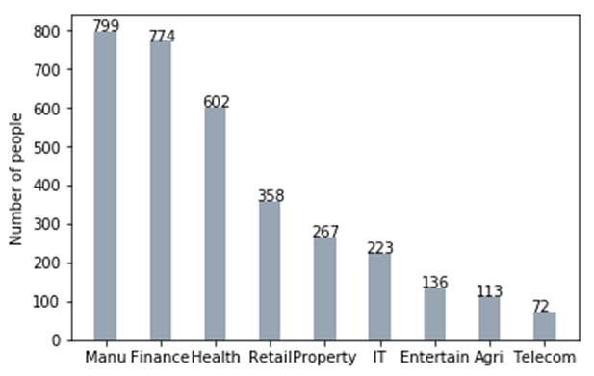
Note: The data and information in this document is reflective of a hypothetical situation and client. This document is to be used for KPMG Virtual Internship purposes only.
Model Development
Wealth Segments and Job Industry
We should focus more on Mass Customers then high net customers and after that affluent customers.
Manufacturing and finance are on the top whereas there are not many changes in other industries.
Place any supporting images, graphs, data or extra text here.

Slide 6
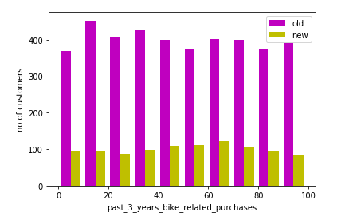
Note: The data and information in this document is reflective of a hypothetical situation and client. This document is to be used for KPMG Virtual Internship purposes only.
Interpretation
It can be easily seen that factors like wealth segments, age distribution and Job industry of the customer matters while purchasing a new brand.
There are various factors also that can be explored to get better results like number of cars owned, bike purchased, gender of the customer and job title.

Slide 7
Note: The data and information in this document is reflective of a hypothetical situation and client. This document is to be used for KPMG Virtual Internship purposes only.
Appendix

Slide 8
Note: The data and information in this document is reflective of a hypothetical situation and client. This document is to be used for KPMG Virtual Internship purposes only.
Appendix
This is an optional slide where you may place any supporting items.

